Slide 1
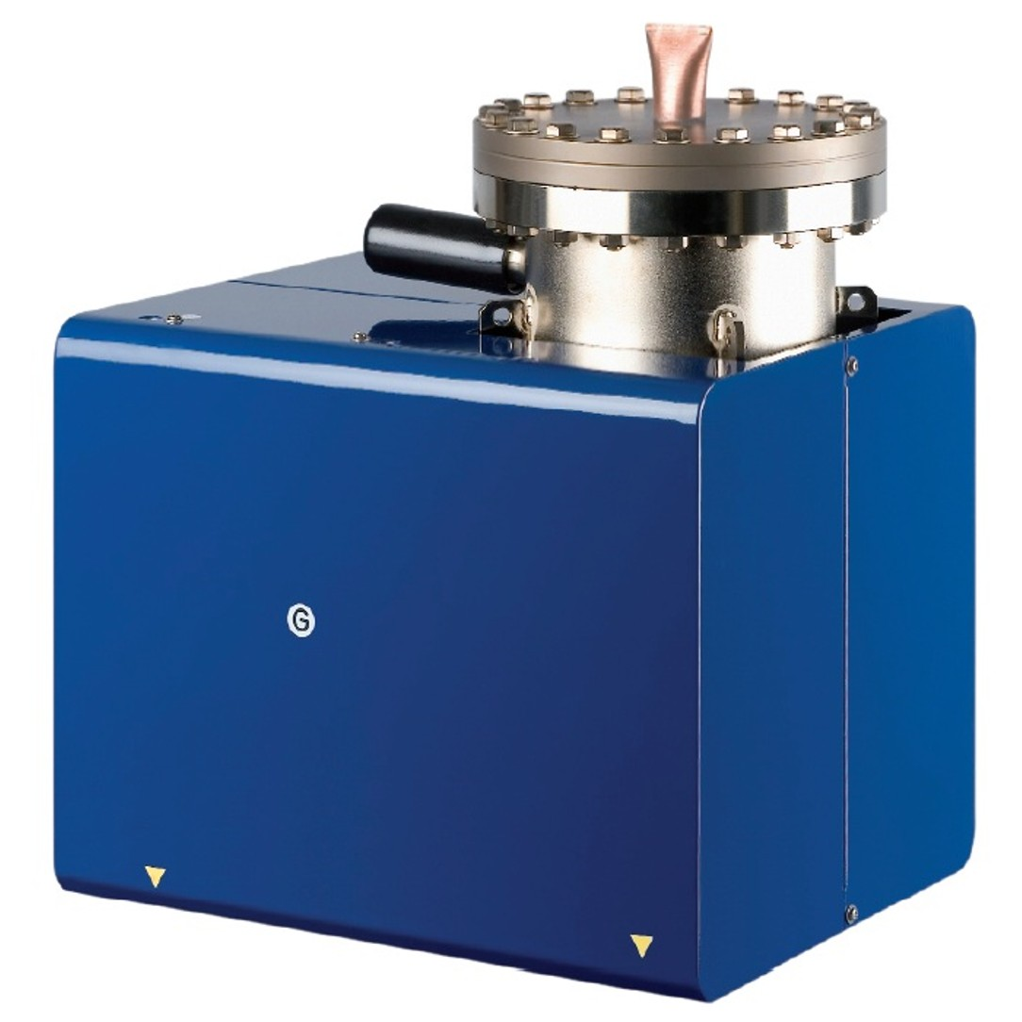
ION PUMPS
By: Nima Moghimian

Slide 2
Why pump?
Why vacuum?
What is a good vacuum?

Slide 3
What is a good vacuum?
NO Vacuum
Rough Vacuum
Low Vacuum
High Vacuum
(HV)
Ultra High Vacuum
(UHV)
Pa
1Pa = 7.5 x 10⁻³ Torr

Slide 4
Types of pumps
NO Vacuum
Rough Vacuum
Low Vacuum
High Vacuum
(HV)
Ultra High Vacuum
(UHV)
Ion pumps
Turbomolecular pumps
Diffusion pumps
Rotary and Dry pumps
Pa

Slide 5
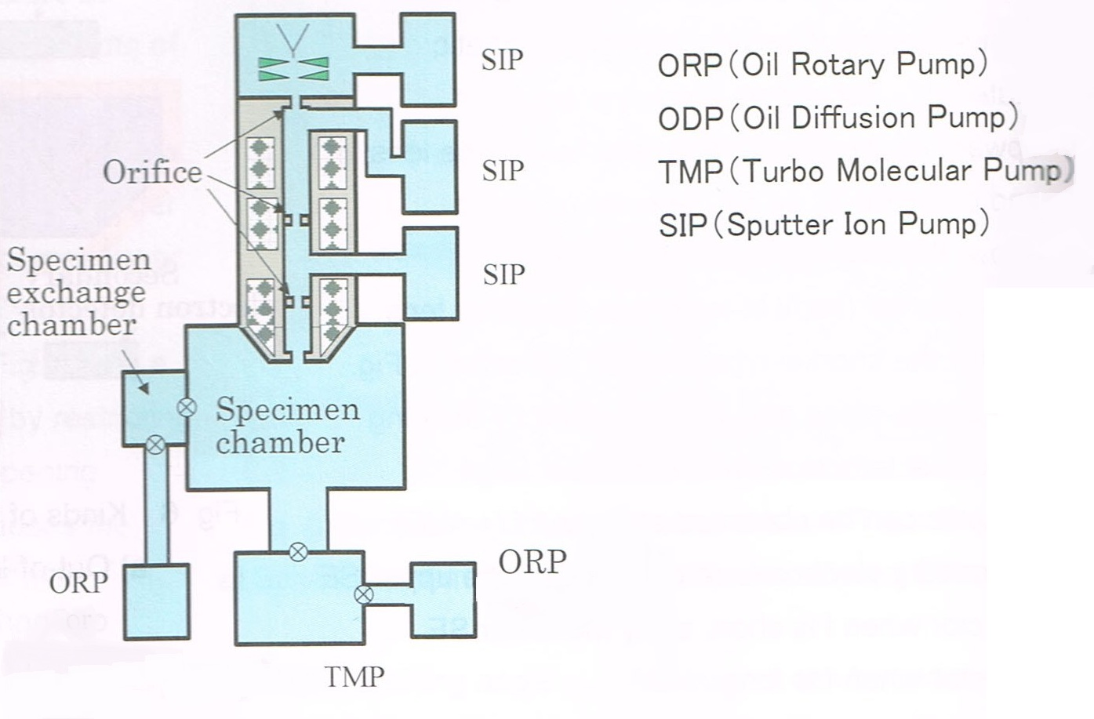
SEM pumps
10⁻⁸ Pa
10⁵ Pa
10⁻¹ Pa
10⁻⁴ Pa

Slide 6
Ion pump
N
anode
S
Ti
Ti
+
DC Power supply
_

Slide 7
Ion pump
+ + + + + + + + + + +
N
S
-
-
-
-
-
-
-
-
-
-
-
-
e
e
e
e
e
e
+ + + + + + + + + + +
+
DC Power supply
_

Slide 8
+ + + + + + + +
e
_ _ _ _ _ _
+
Collision
Ionization
Sputtering
Condensation
e
+

Slide 9
N
S
Electrical attraction
Chemisorption
+
DC
Power supply
_

Slide 10
N
_
_
_
_
_
_
_
_
+ + + + + + + + + + + + + +
_
_
_
_
_
_
_
_
S
+
e
+
e
+ + + + + + + + + + + + + +
+
DC
Power supply
_

Slide 11
Ion pump features
No Oil
No moving parts
Only efficient at high vacuums

Slide 12
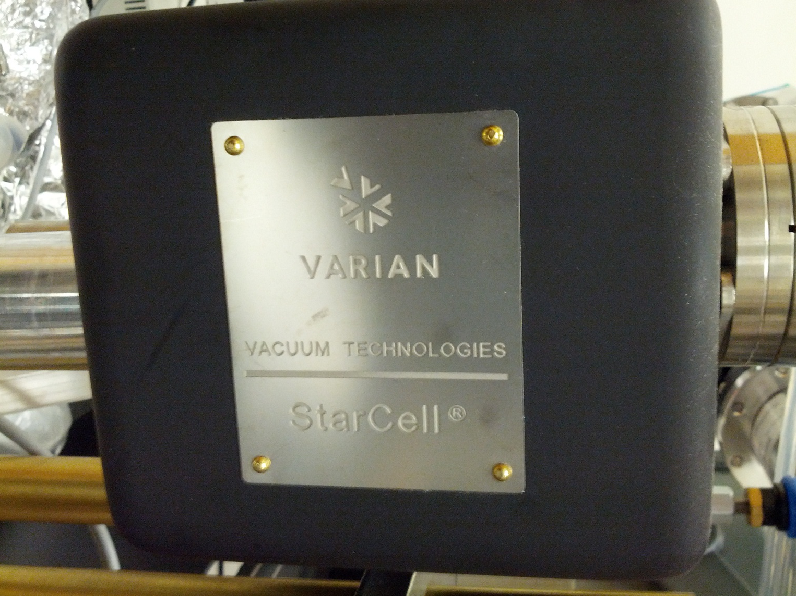
Questions

